Slide 1
State Road 234 & County Road 200 W.
Intersection Improvement Project
Des. No. 2300706
Public Information Meeting
September 23, 2026
Hancock County
Notes:
Good evening and thank you for joining us for the Public Information Meeting for the State Road 234 and County Road 200 West Intersection Improvement Project in Hancock County.
Tonight’s meeting is an opportunity to learn more about the project, and share your thoughts on the proposed improvements.

Slide 2
Welcome
Benefits of Roundabouts
Proposed Design
Turning Movements
Roadway Cross Section
Project Schedule
Ways to Comment
Submit Public Comments
Project Overview
Purpose & Need
Environmental Analysis
Alternative Analysis
Preferred Alternative
Conflict Points
Notes:
During this presentation, we’ll provide an overview of the project and explain the purpose and need for the proposed improvements. We’ll also discuss the environmental analysis and the different alternatives considered before introducing the selected preferred alternative. From there, we’ll take a closer look at how the proposed roundabout would reduce congestion, share details of the proposed design, and the features that accommodate vehicles of all sizes. We’ll then review the anticipated project schedule and remind you how to provide comments. Public input is an important part of this process, and we encourage you to share your questions, concerns, and comments with the project team.

Slide 3
Submit Comments
  Public Comment Form
  mailed to: Sam Smith, Lochmueller Group 3502 Woodview Trace, Suite 150
  Indianapolis, IN 46268
  Via e-mail: Sam.Smith@lochgroup.com
The comment period deadline to have your comment included in the project record is:
October 8, 2026
Notes:
You have several options for submitting a comment. You can mail them to Sam Smith, at the address on the screen Or you can e-mail your comments to Sam.Smith@lochgroup.com. Comments are requested by October 8 so they can be shared with the project team.

Slide 4
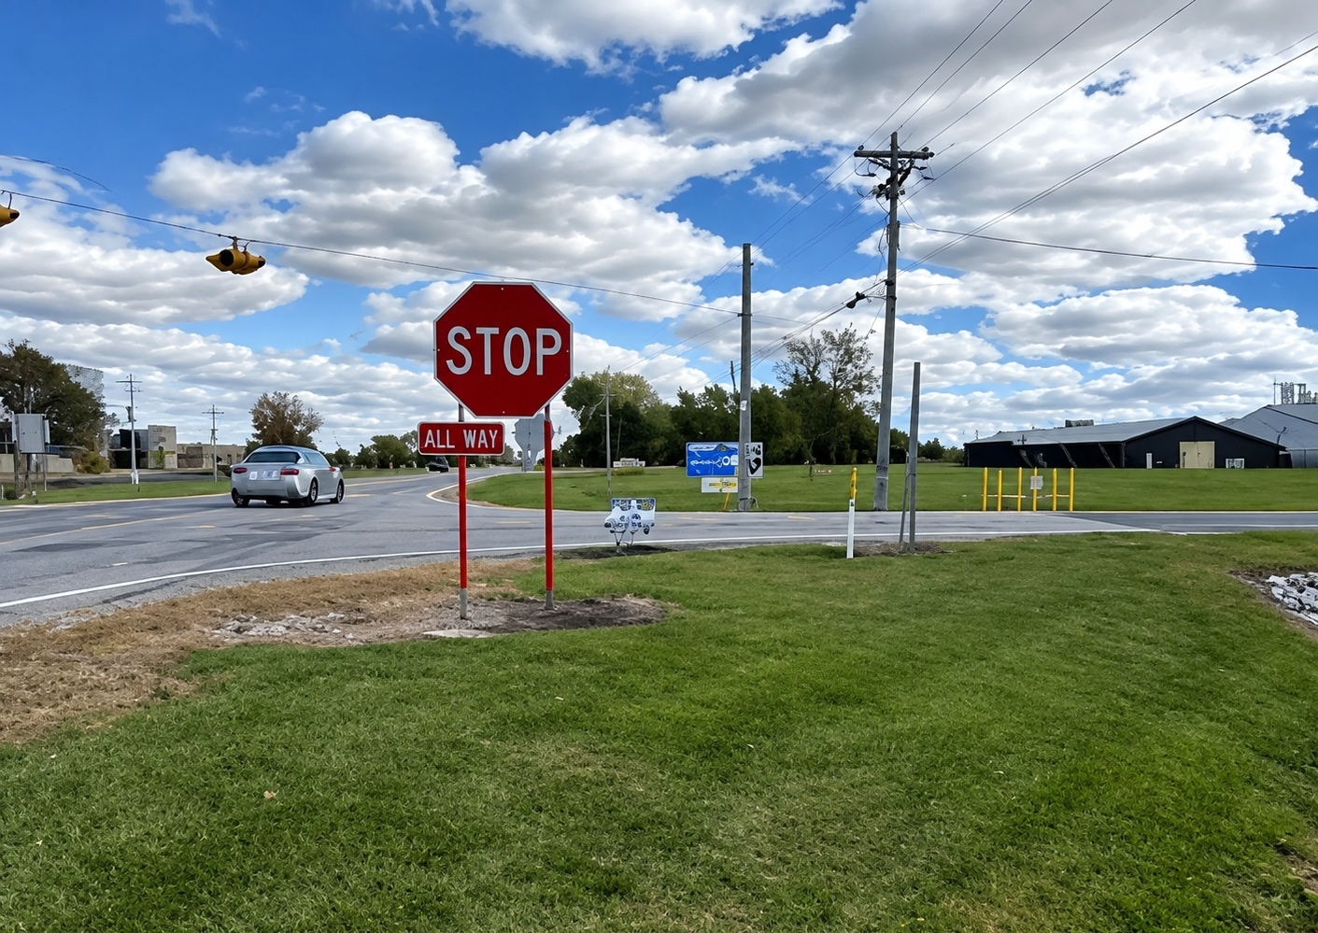
Project Overview
Notes:
The project is located at the intersection of State Road 234 and County Road 200 West in Hancock County, near the Town of Fortville and the Mount Vernon Community School District campus. The existing intersection is an all-way stop, with one travel lane in each direction. Because of its location near the school campus, the intersection experiences particularly heavy traffic during school arrival and dismissal periods. During these peak travel times, motorists can experience significant congestion, queuing, and delays. Law enforcement currently assists with directing traffic through the intersection during the morning and afternoon school peak periods.

Slide 5
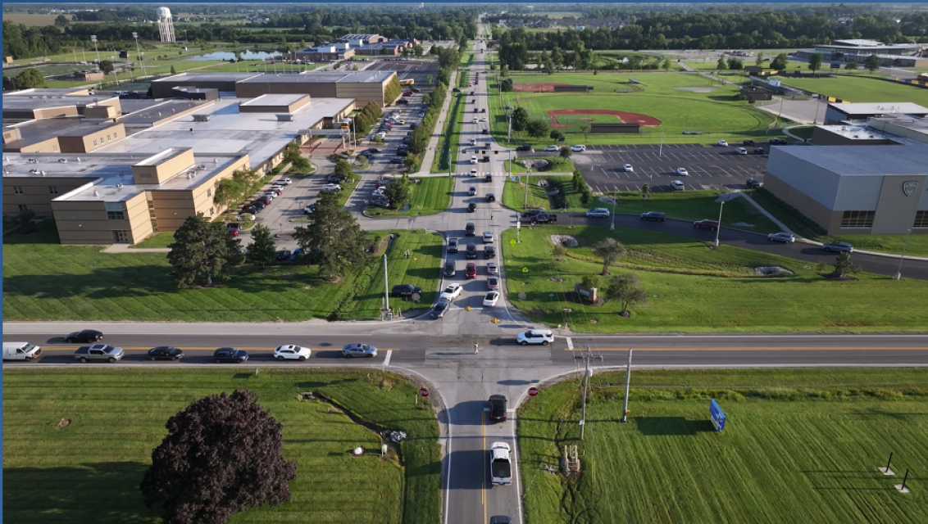
Existing Conditions
Notes:
Here we see a good example of the congestion drivers currently experience at the intersection of State Road 234 and County Road 200 West. As you can see, during the busiest times of the day, vehicles can begin to back up as drivers wait for an opportunity to safely enter or travel through the intersection. As mentioned, during peak traffic periods, law enforcement helps manage the flow of vehicles through the intersection and keep traffic moving as efficiently as possible. While this provides some assistance under existing conditions, it does not address the intersection’s long-term congestion concerns. While the video provides a snapshot of what drivers experience today, traffic volumes are expected to continue to grow in the future. Without improvements, the amount of congestion at the intersection is expected to increase, resulting in longer backups and additional delays for drivers. Reducing these delays and backups, while helping traffic move more safely and efficiently through the intersection, is a primary focus of this project.

Slide 6
Project Need
The need for the project is due to traffic congestion, queuing, and delays at the existing intersection, particularly during the morning peak period when students are arriving at the Mount Vernon school campus.
Notes:
The primary need for this project is to address the congestion, queuing, and delays that occur at the intersection of State Road 234 and County Road 200 West particularly during the morning peak period.
Traffic operations are measured using Level of Service, or LOS, and just like at school, grades range from A through F. Later we’ll share more about the grades this intersection receives and what can be expected with the improvements

Slide 7
Project Purpose
The purpose of the project is to reduce congestion and improve traffic operations at the intersection of S.R. 234 and C.R. 200 W.
Notes:
The purpose of this project is to improve how traffic moves through the intersection of State Road 234 and County Road 200 West. As we just discussed, motorists are already experiencing congestion and delays, particularly during the morning school peak period, and those conditions are expected to worsen as traffic volumes increase. The goal of the project is to provide a long-term improvement that reduces those delays and allows the intersection to operate at Level of Service C or better through the design year of 2048. In addition to improving traffic operations, the project will consider safety for motorists and others traveling through the intersection as the proposed improvements are developed.

Slide 8
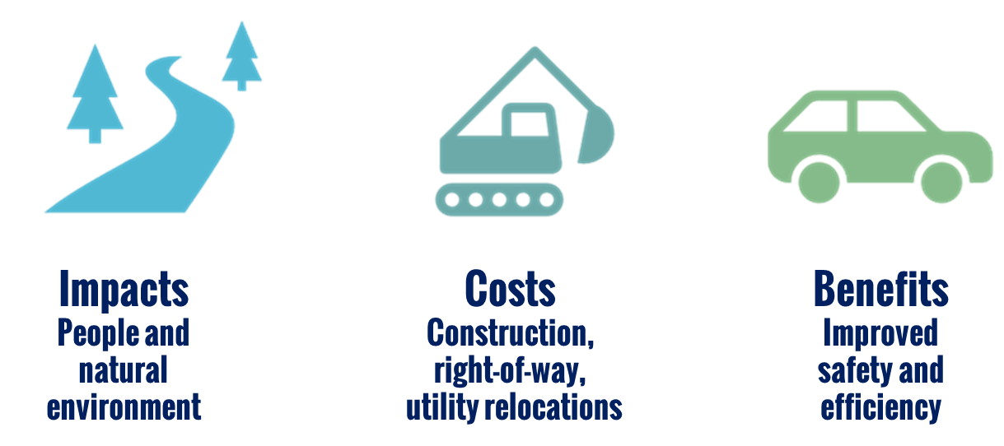
Environmental Analysis
Notes:
As part of the environmental process, the project team evaluates each alternative by balancing its impacts, costs, and benefits. This includes looking at potential effects on people and the natural environment, construction and right-of-way needs, and utility relocations. These factors are then weighed against the project's expected benefits, such as improving safety and traffic operations, to identify the preferred alternative.

Slide 9
Alternative Analysis
No Build
Traffic Signal
Roundabout
Notes:
With the project’s purpose in mind, we evaluated several possible alternatives for this intersection. First, we looked at a no-build option, which would leave the intersection as it is today. We also analyzed the use of a traffic signal. Finally, we considered the benefits of a roundabout. Each of these alternatives was reviewed to determine how well it would address traffic congestion and queuing at this location.

Slide 10
Alternative Analysis
No Build
Meets Purpose and Need?
Reason: Does not reduce congestion – current level D and predicted to reach F
Notes:
The first option was to do nothing – or what we call no build. Earlier in the presentation we mentioned Level of Service – it’s how we measure how well an intersection operates and the traffic’s flow. Level of Service A represents traffic operating with very little delay, while Level of Service F represents significant congestion and delay.
Today, several movements at the intersection already operate at Level of Service D or worse during the morning peak period. As traffic volumes increase over time, these conditions are expected to worsen. By the design year of 2048, all approaches to the intersection are projected to operate at Level of Service F during the morning peak period if improvements are not made.
The no build alternative doesn’t address the operational concerns identified in the purpose and need and for that reason it wasn’t carried forward as an option.

Slide 11
Alternative Analysis
Traffic Signal
Meets Purpose and Need?
Reason: Doesn’t meet LOS C threshold
Notes:
This alternative would include installation of a traffic signal at the existing intersection, along with the addition of a turn lane for each approach. The estimated construction cost for this alternative is less than the roundabout alternative. However, based on the projected traffic conditions for the design year (2048), the Traffic Signal Alternative would not achieve the desired level of service of C or better for each approach, with some approaches operating at LOS D during the AM peak period. Therefore, while the Traffic Signal Alternative would improve existing intersection operations, it would not fully meet the project's purpose and need.
Additionally, installing traffic signals can cause a rise in rear end crashes and the potential for dangerous, right-angle crashes remain with the addition of a traffic signal.

Slide 12
Preferred Alternative
Roundabout
Meets Purpose and Need?
Reason: Improves safety and efficiency
Notes:
After careful analysis, the preferred alternative for this project is a roundabout. The roundabout meets the project purpose and need by addressing the primary operational deficiencies at the intersection and providing LOS A during both the AM and PM peak hours.
Additional benefits of the roundabout include:
Improved safety through a reduction in the number of vehicle conflict points and elimination of high-speed, right-angle movements that can result in more severe crashes.
Reduced vehicle speeds through the intersection, which can reduce both the frequency and severity of crashes.
Accommodates large vehicles, including semis, school buses and emergency responders, while maintaining efficient traffic flow.
Based on its operational and safety benefits, as well as its ability to accommodate all users, the roundabout was selected as the preferred alternative.

Slide 13
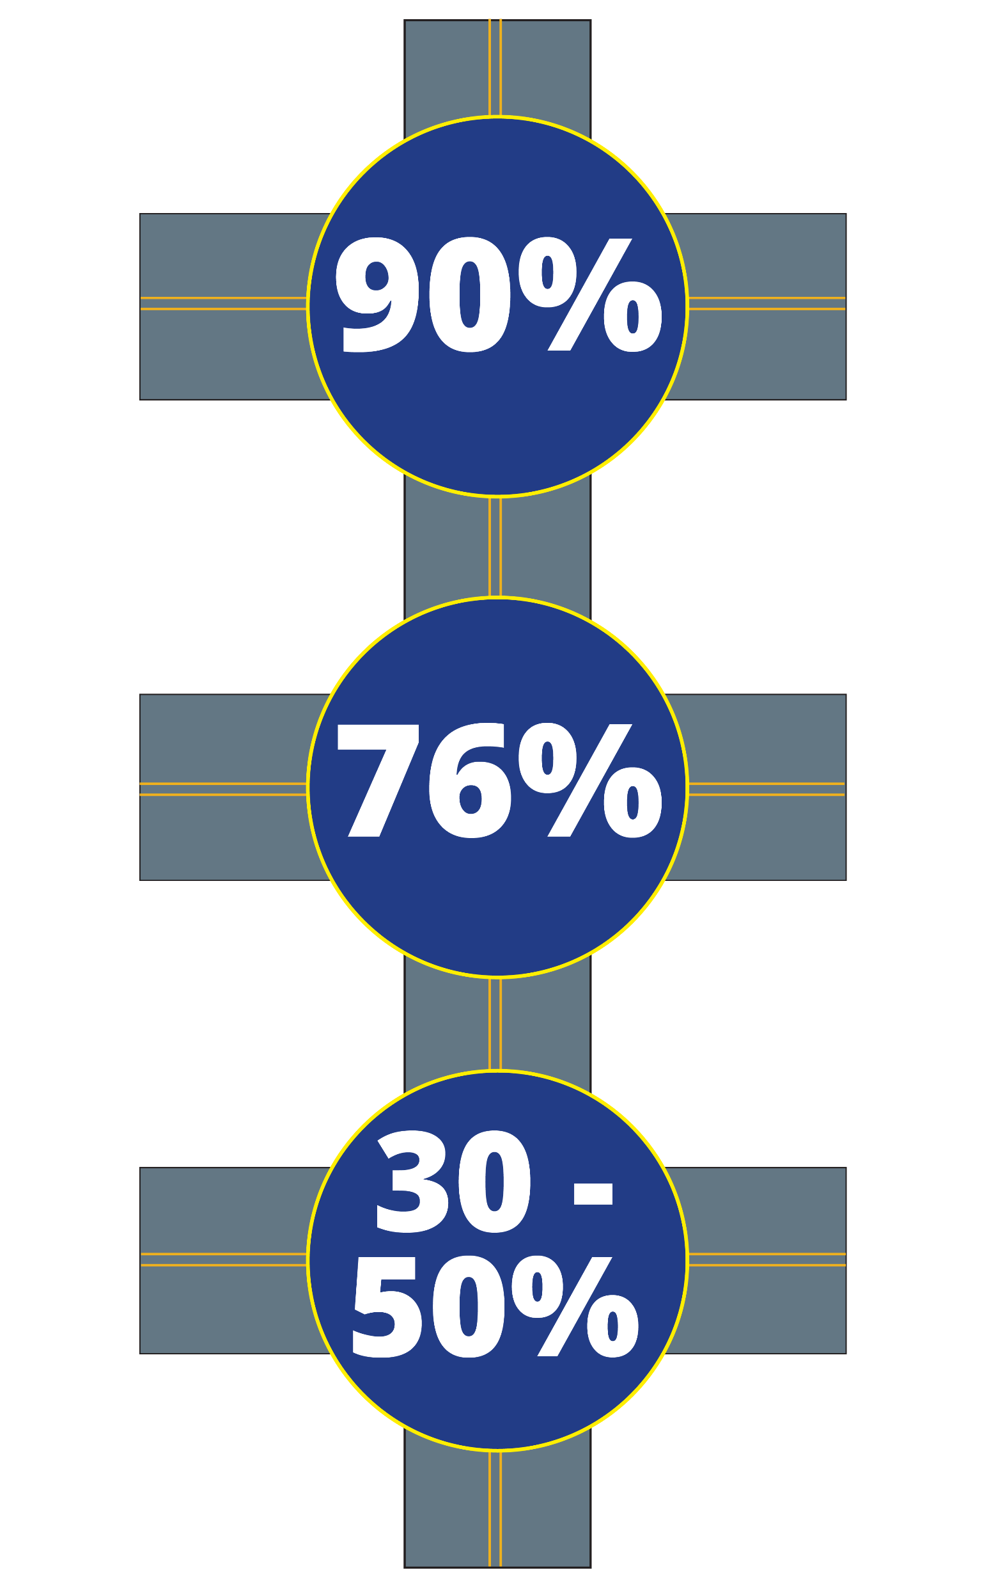
Roundabout Benefits
90% reduction in fatal and incapacitating crashes
76% reduction in all injury crashes
Designed to lower speed
30-50% capacity increase
No equipment maintenance
Traffic calming
Source: Insurance Institute for Highway Safety
Notes:
Studies have shown that roundabouts can reduce fatalities by up to 90 percent and reduce injury crashes by approximately 76 percent. In addition to safety improvements, roundabouts increase intersection capacity by approximately 30 to 50 percent compared to traditional stop-controlled intersections – which is key to improving operational flow at the intersection.

Slide 14
Level of Service (LOS) - 2048
All-Way Stop Controlled |  | Roundabout
LOS | Delay Times | LOS | Delay Times
 | 5+ minutes |  | 7 seconds
F
A
Notes:
As discussed, Level of Service, or LOS, is a way we measure how efficiently traffic moves through an intersection. This graphic compares how the intersection is expected to operate in the design year of 2048 under the current all-way stop configuration versus the proposed roundabout. If the intersection remains an all-way stop, it is projected to operate at a Level of Service F, with drivers experiencing up to 5 minute delays during the morning peak period. With the proposed single-lane roundabout, the intersection is projected to operate at a Level of Service A and reduces the same delay to 7 seconds. So, when comparing the two options, the roundabout is expected to significantly reduce the amount of time drivers spend waiting at the intersection and allow traffic to move much more efficiently, even as traffic volumes increase through 2048.

Slide 15
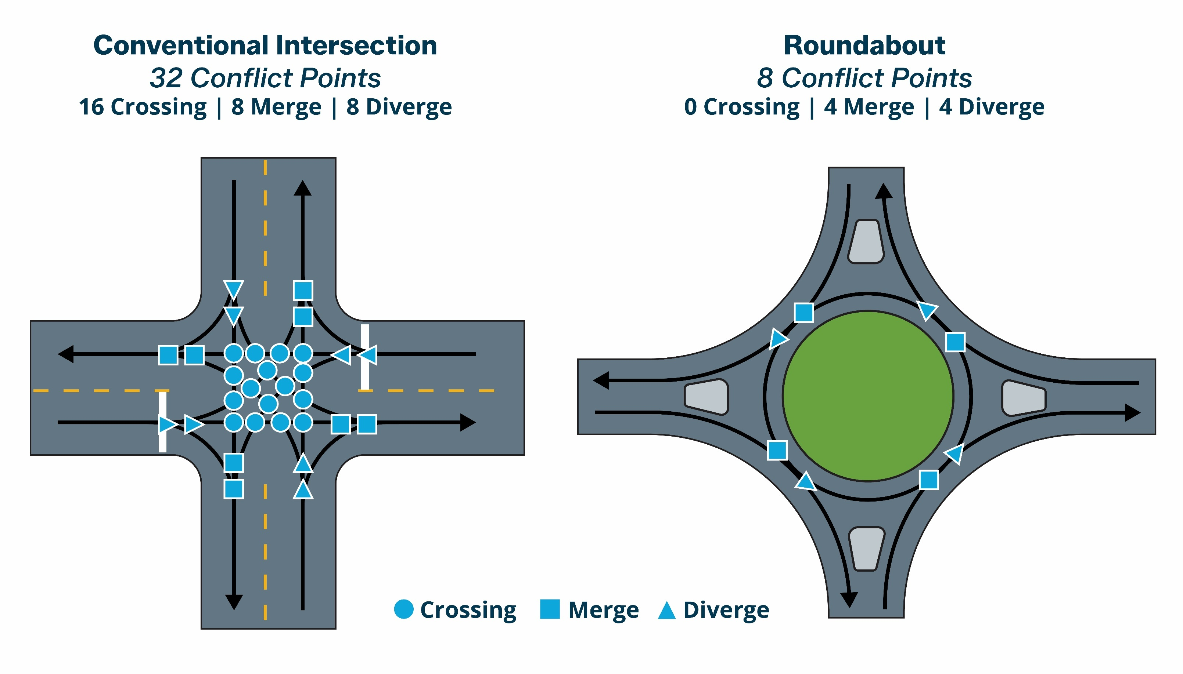
Conflict Points
Notes:
One of the primary safety benefits of a roundabout is the reduction in conflict points, or locations where the paths of vehicles can potentially cross. A conventional four-way intersection has 32 conflict points, including 16 crossing points. A roundabout reduces that number to just eight conflict points and eliminates crossing conflicts altogether. This is especially important because crossing conflicts are what can result in more severe right-angle or T-bone crashes. By reducing these conflict points and slowing vehicles as they enter the intersection, roundabouts can help reduce both the number and severity of crashes.

Slide 16
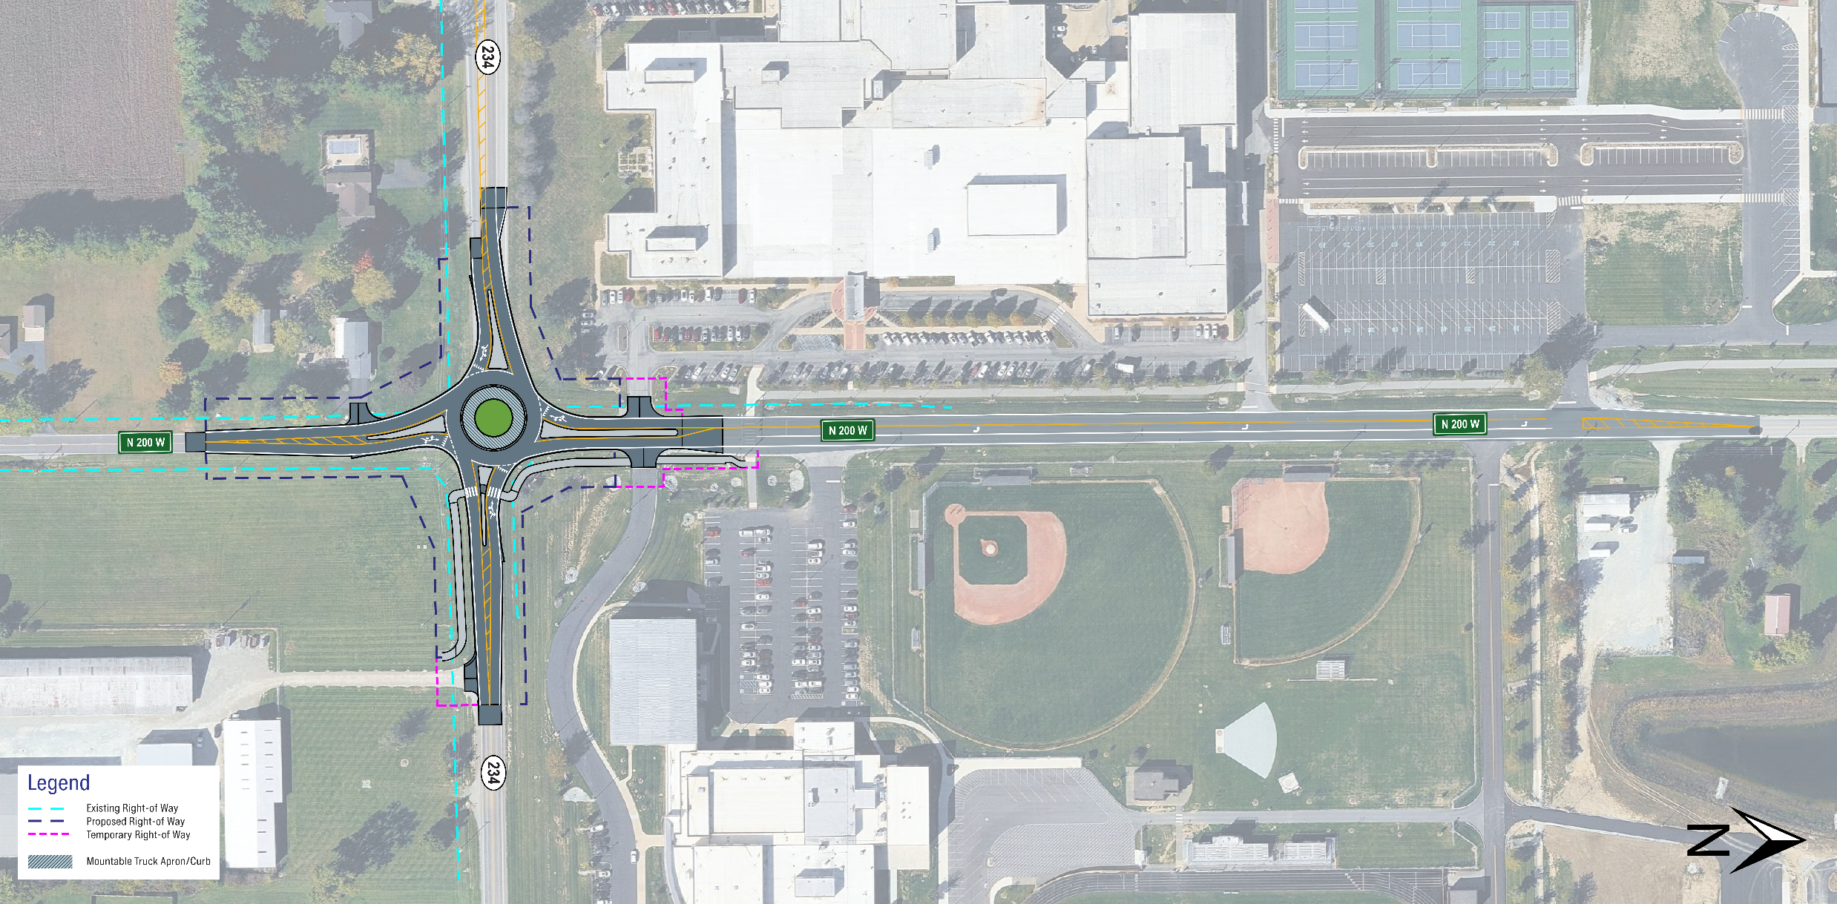
Proposed Design
Notes:
Now that we’ve discussed the alternatives that were considered, we’ll take a closer look at the proposed design for the intersection. The proposed improvement consists of constructing a single-lane roundabout at State Road 234 and County Road 200 West. The roundabout would include an 18-foot-wide circulating roadway, with splitter islands provided on each approach to help guide motorists into the roundabout and encourage lower speeds as they enter the intersection. Moving north of the intersection, County Road 200 West would be re-striped to include a northbound left-turn lane that extends approximately 1,000 feet north of the roundabout to help accommodate school traffic. The proposed design also includes a multi-use path within the northeast and southeast quadrants of the intersection. Together, these improvements are intended to provide more efficient traffic flow through the intersection while improving safety and accommodating the different users who travel through the area.

Slide 17
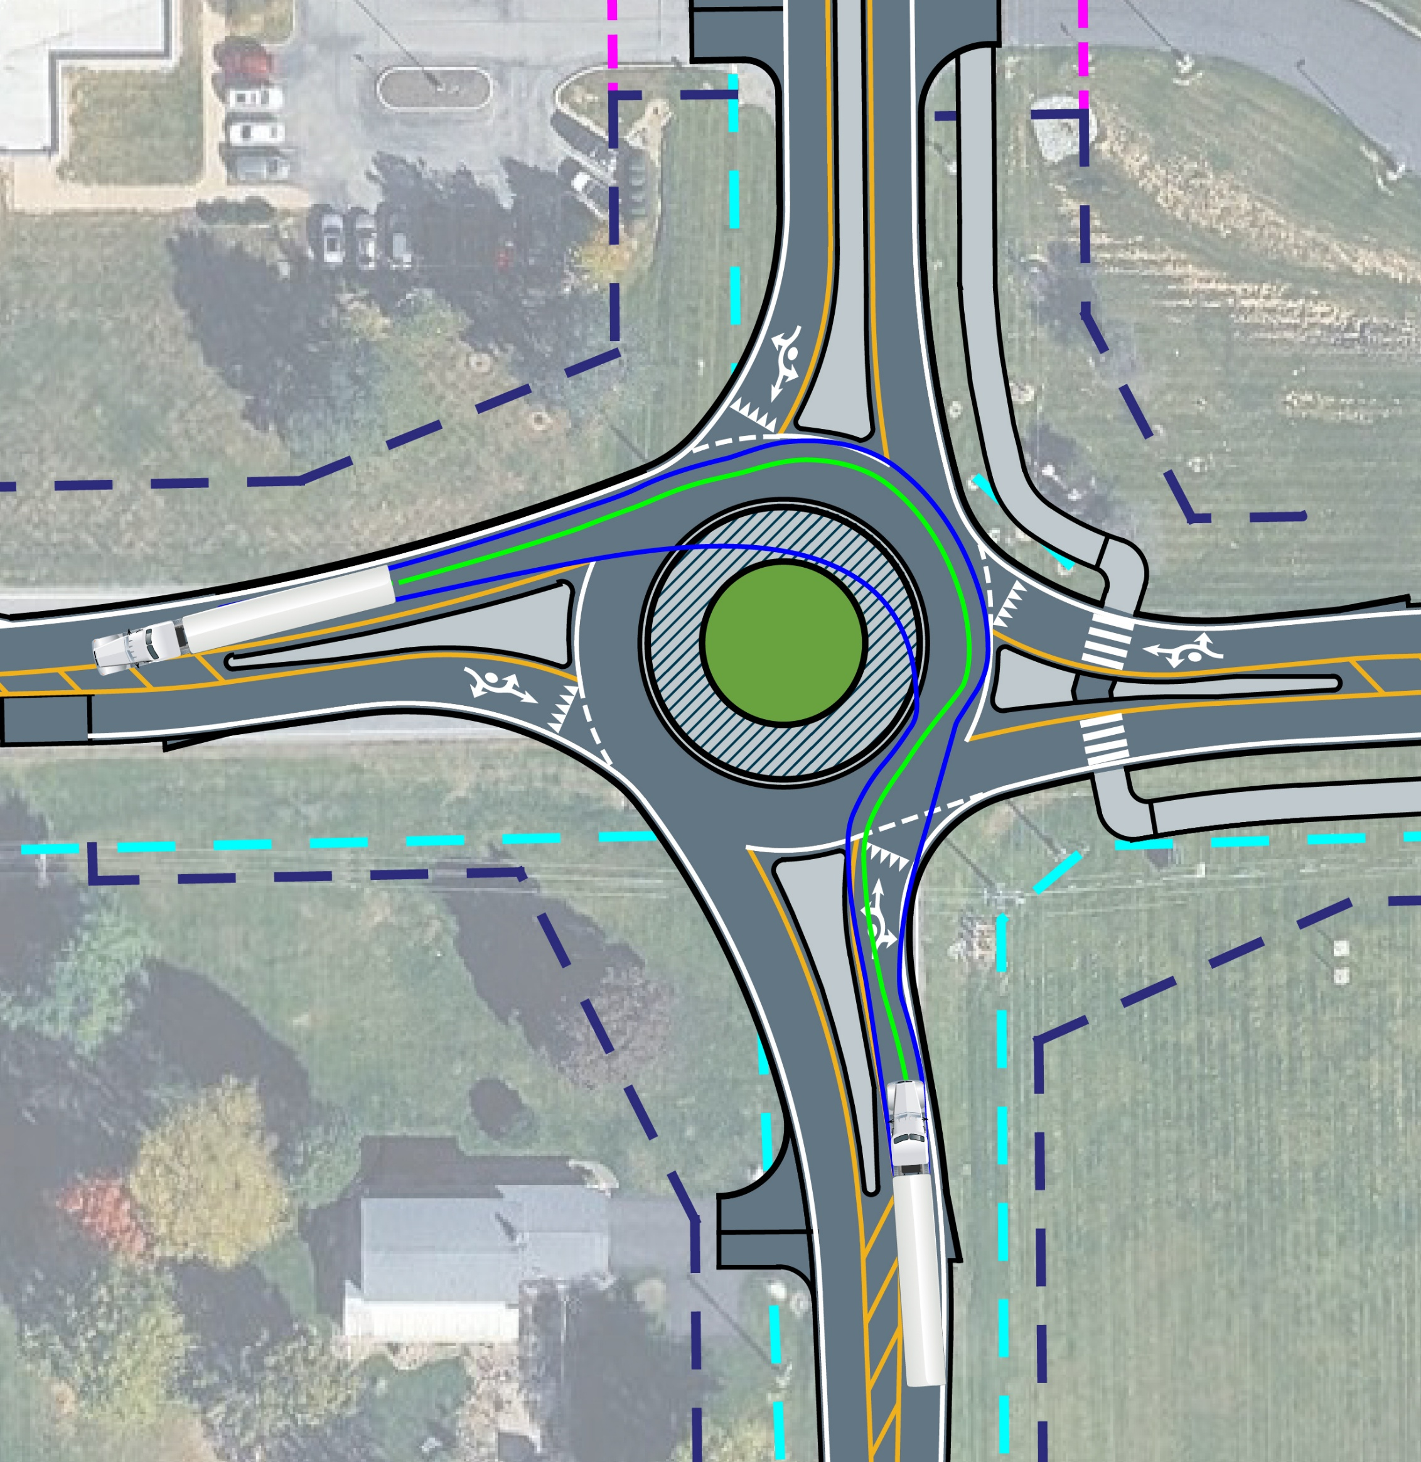
Semi-Trailer
Turning Path
73 feet long
Notes:
Here we can see the proposed roundabout is designed to accommodate larger vehicles, including a 73-foot-long semi-trailer. The lines on the graphic help illustrate how the truck moves through the roundabout. The solid green line represents the centerline of the vehicle, showing the general path the semi follows as it travels through the intersection. The solid blue line represents the wheel path, showing where the truck’s wheels travel as it makes its way around the roundabout. Because semi-trailers require more room to turn than passenger vehicles, the roundabout also includes a mountable truck apron around the center island. This provides additional space for the rear wheels of larger vehicles to track across the truck apron when needed. As you can see from the turning path shown here, the roundabout has been designed to provide enough space for a 73-foot semi-trailer to safely navigate the intersection

Slide 18
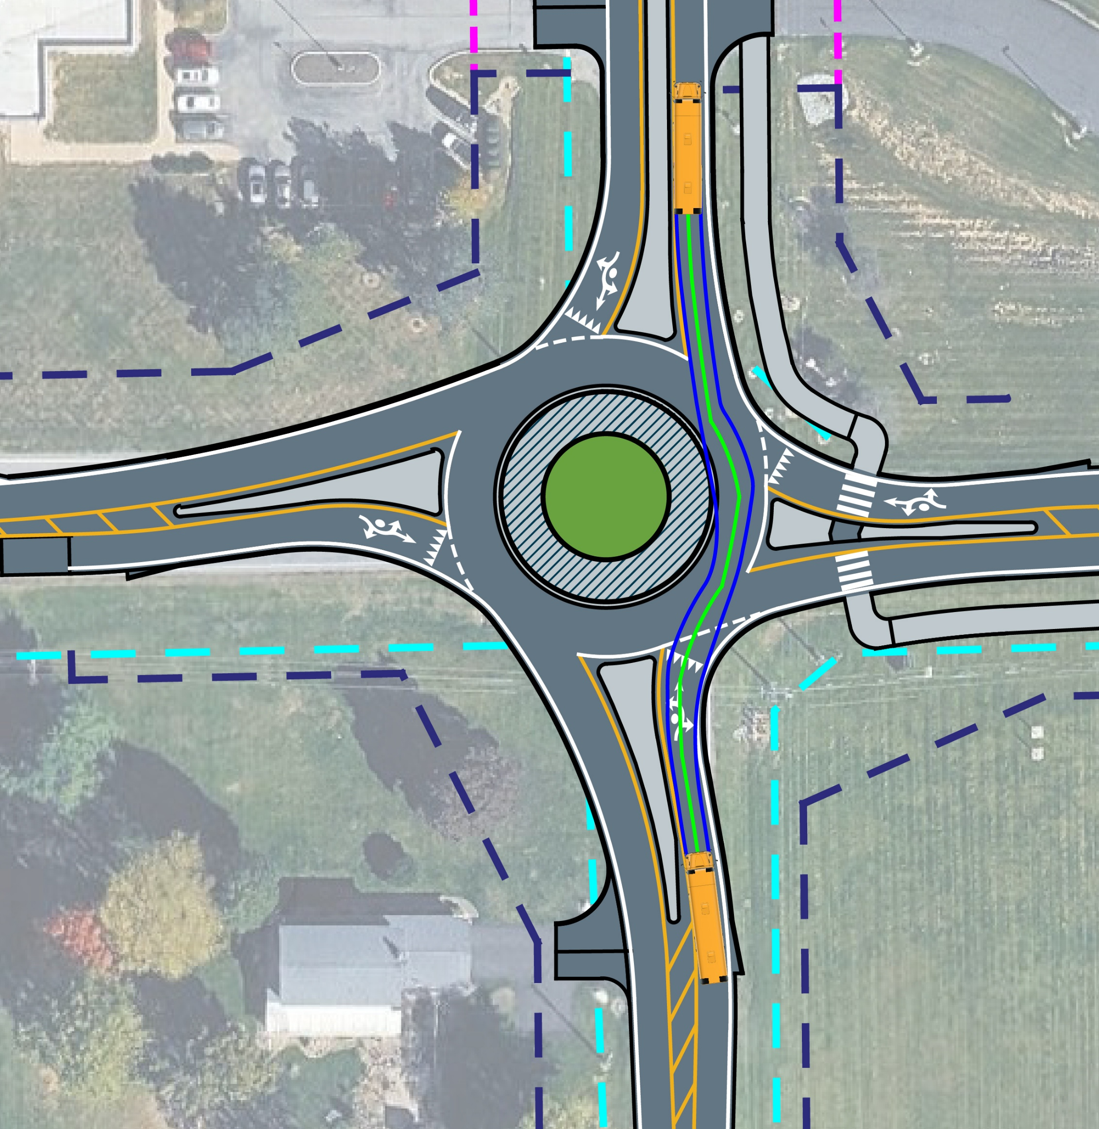
School Bus Turning Path
40 feet long
Notes:
We also ran a school bus through our simulation. At 40 feet long, it navigates the intersection with ease. Utilizing the mountable sections, a school bus is able to safely and efficiently navigate the intersection.

Slide 19
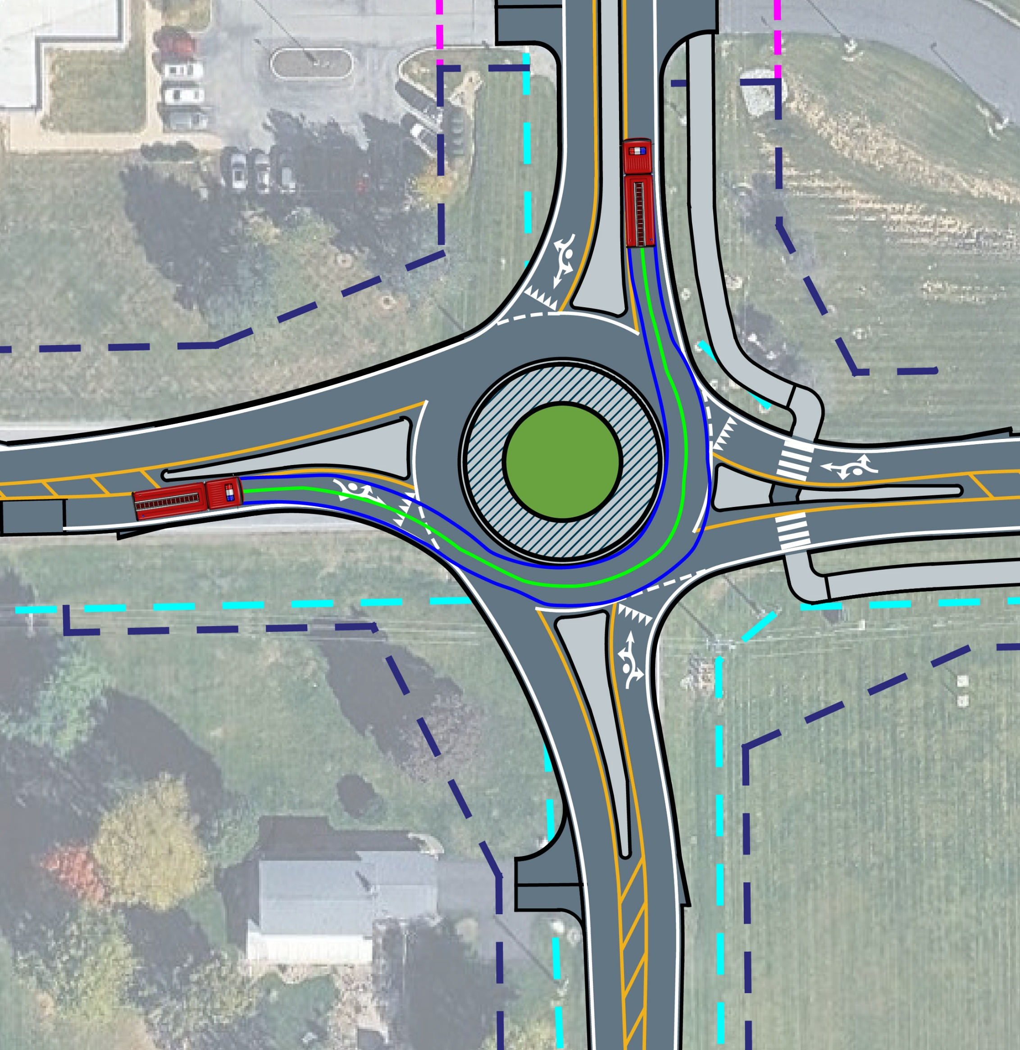
Fire Truck Turning Path
40 feet long
Notes:
Finally, we ran a fire truck through our simulation. At 40 feet long a fire truck has no trouble using a roundabout. It can navigate the intersection without using the truck apron.

Slide 20
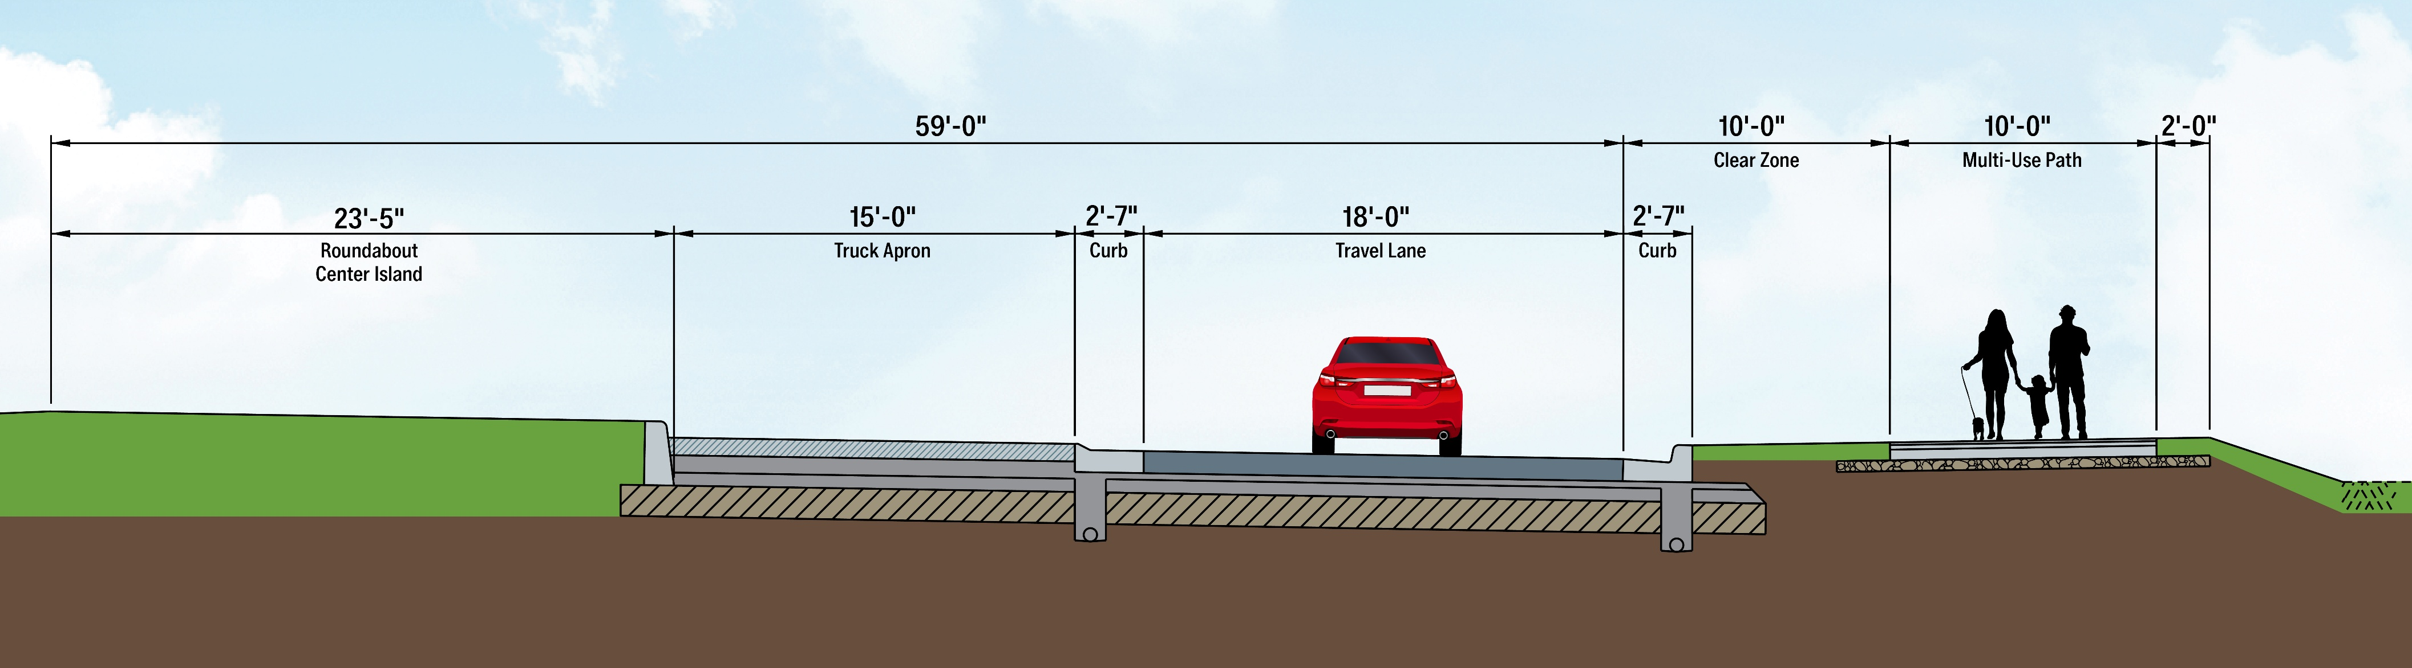
Roadway Cross Section
Roundabout
Notes:
Next, we’ll look at a cross section of the roadway and the different features that make up the proposed roundabout. The design features a 47-foot center island surrounded by a 15-foot-wide truck apron. As we discussed, the truck apron provides additional space for larger vehicles. The roundabout will have an 18-foot-wide travel lane. A 10-foot clear zone will provide additional separation between vehicle traffic and the multi-use path. A 10-foot-wide multi-use path will be provided for pedestrians and cyclists on portions of the project. Together, these features are designed to provide enough space for everyday traffic and larger vehicles, while also providing accommodations for pedestrians and bicyclists traveling through the area.

Slide 21
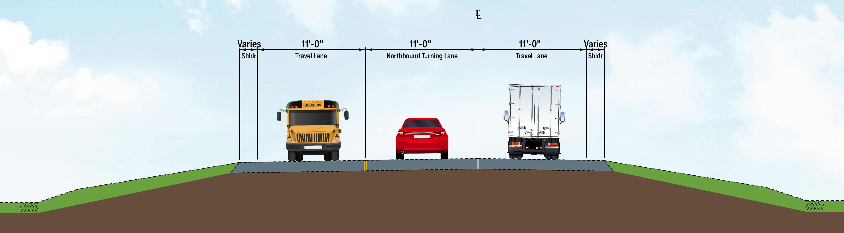
Roadway Cross Section
N. C.R. 200 W. Restriping
Notes:
As part of the proposed improvements, County Road 200 West will also be restriped north of the roundabout to help improve school traffic flow. The roadway will include 11-foot-wide travel lanes in each direction, along with a dedicated northbound turn lane. This additional turn lane will provide space for vehicles waiting to turn without blocking through traffic. The existing shoulders along County Road 200 West will remain variable in width. These improvements will help better organize traffic along County Road 200 West and reduce the potential for turning vehicles to contribute to backups, particularly during the busiest times of the day.

Slide 22
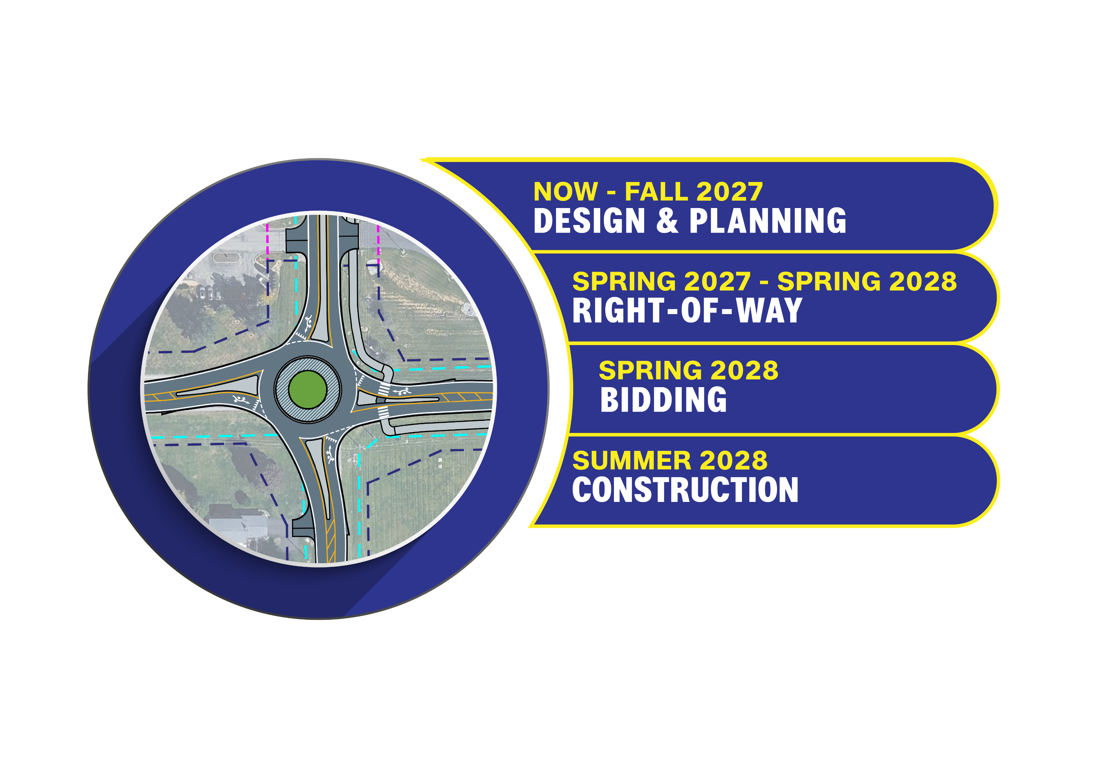
Proposed Project Schedule
Notes:
We are currently in the design and planning phase, which is expected to continue through fall of 2027. During this time, the project team will continue refining the design and incorporating feedback received through the public involvement process. The right-of-way acquisition process is anticipated to begin in spring of 2027 and continue through spring of 2028. Property owners who may be directly impacted will be contacted individually as that process moves forward. The project is currently anticipated to move into bidding in spring of 2028, when INDOT will select a contractor to construct the improvements. Construction is then anticipated to begin in summer of 2028. As we move through these different phases, the project schedule may continue to be refined, and we’ll keep the public informed of any significant updates or changes.

Slide 23
Thank You
Written Comments
By Email Sam.smith@lochgroup.com
By Mail Sam Smith, 3502 Woodview Trace, Suite 150, Indianapolis, IN 46268
Website eastcentral.indot.in.gov
Voice Recorded Message
INDOT Customer Service (855) 463-6848
Comments are due October 8
Notes:
That concludes our presentation. On behalf of INDOT and the project team, we want to thank you for taking the time to join us and learn more about the proposed improvements at State Road 234 and County Road 200 West. Your feedback is an important part of the project development process, and we encourage you to share any comments, questions, or concerns you may have. Written comments can be submitted by email or mail using the contact information shown here, or through the project website. You can also leave a voice-recorded comment by contacting INDOT Customer Service at 855-463-6848. Again, thank you for your time, your participation, and your interest in this project.

